Slide 1


Slide 2





The Inadequacy Of Foundational Measurement And Data Infrastructures Is A Cause of Implementation Problems
No learning behavioral health care system that collects data on services and outcomes to enhance practice
U.S. lacks a data collection system to assess benefits of treatment
AI development necessitates substantial data sets and real-world experimentation
Enhancing CDS with AI could enhance its adoption and performance
Precision Mental Health needs extensive longitudinal data sets

Slide 3
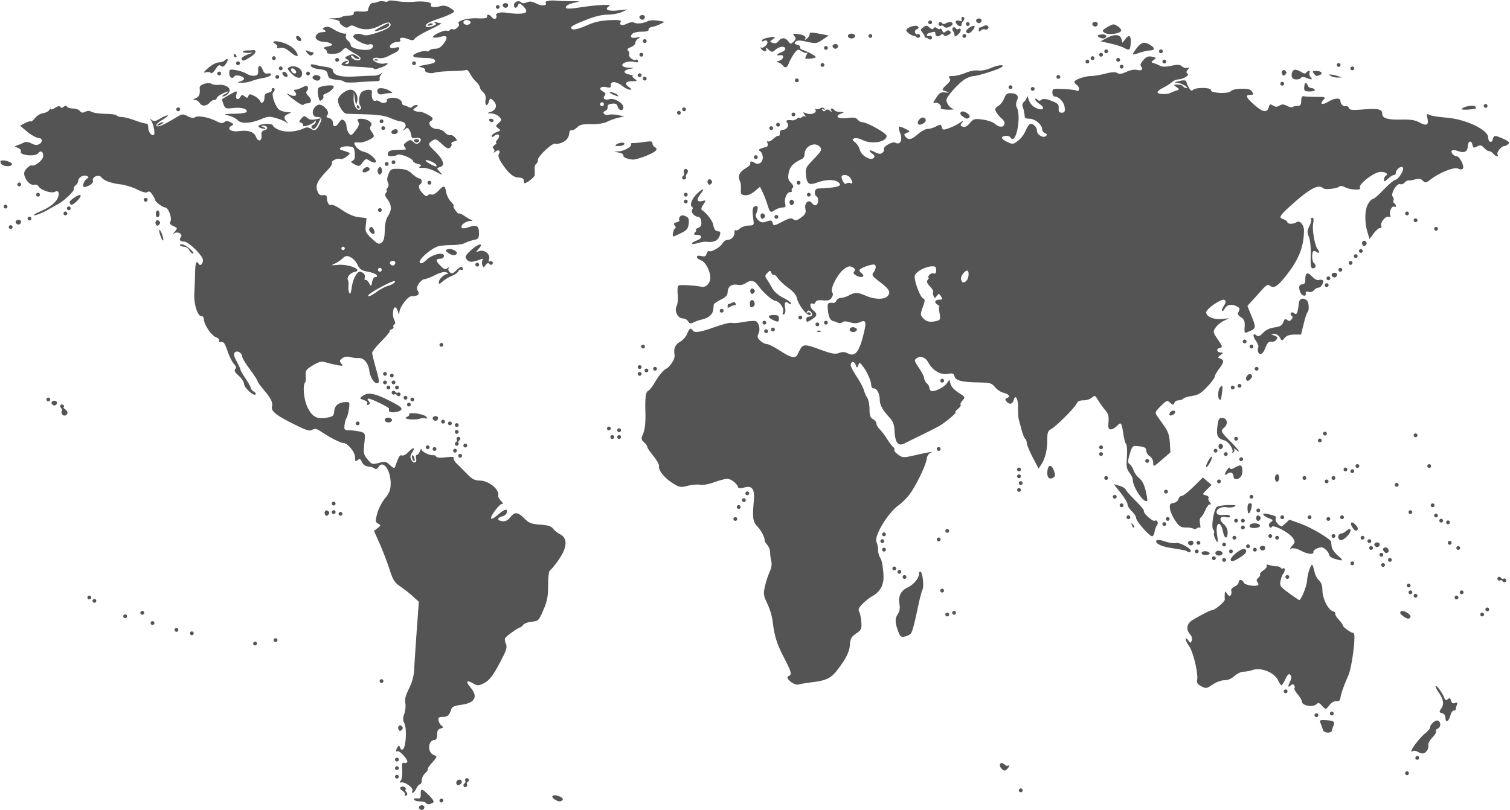


SUCCESSFUL INFRASTRUCTURE MODELS OUTSIDE THE US...
The Health Outcomes Observatory in Europe
The English National Health Service's Talking Therapies program for anxiety and depression
New Zealand's Integrated Data Infrastructure

Slide 4




What should such an infrastructure contain?
Data
Longitudinal mental health outcome measures
Consumer and provider characteristic measures
Continuous implementation fidelity measures
Cost and service use measure

Slide 5
What should such an infrastructure contain?
Provider Operational Processes and Software
Feasible data collection procedures
Data storage with easy access and sharing
Privacy protection
AI automation enhancements
Data integration and interoperability with EHRs

Slide 6
What should such an infrastructure contain?
Training and Technical Assistance
Financial incentives for Data Collection and Training
Support for partnerships with researchers

Slide 7


New Science, Tech, and Policy Shifts...
New Implementation sciences combined with translational sciences provide novel solutions

Slide 8


Chatbots
New Science, Tech, and Policy Shifts...
AI-powered assessments
Emerging
Technologies
Ecological momentary assessments
Adaptave technologies
    encryption methods enhance privacy solutions

Slide 9
New Science, Tech, and Policy Shifts...
Medicare and Medicaid aims to enroll beneficiaries in accountable, value-based care programs by 2030

Slide 10



Conclusions about need...
Innovative mental health treatment advancements can enhance effectiveness...
Lack of intensive longitudinal data in routine practice hinders refining innovative approaches...
...but limited adoption related to inadequate infrastructure.
...which further limits their utilization

Slide 11

Proposed Action Plan...
Enhancing an existing infrastructure
Supplying researchers with essential data to enhance service effectiveness.

Slide 12




I propose...
CMHS Director form a subcommittee for infrastructure enhancement
Per NAC Charter and CMHS approval, arrange workshops, conferences, and publications

Slide 13

Use The Certified Community Behavioral Health Clinics (CCBHCs) As The Cornerstone Of The Plan
CCBHCs provide broad mental health and substance service.
500 centers across 46 states serving 2.1 million
The National Council for Mental Wellbeing provides national technical assistance.
Sites contracted electronic health records providers , e. g. Netsmart serves 178 centers in 38 states.

Slide 14

SUGGESTIONS FOR
SUBCOMMITTEE ACTIVITIES...
Explore financial support through existing or new grants
Collaborate with the Technical Assistance Center
Partner with EHR contractors to capturing data voluntarily collected
Collaborate with researchers, providers, and community members to define data needs
Engage with other federal agencies
Assess other infrastructure efforts in the U.S. and elsewhere
Develop a model implementation plan, organizing workshops and conferences for stakeholders.

Slide 15

CREATE EXPERT WORK GROUPS
  Measurement-based care
  Feedback systems
  Evidence-based treatments
  Decision support
  Precision mental health
  Causal data sciences
  AI
  Implementation science
  Data systems
  Privacy
  Consumers
  Families
  Peer workers
  Providers
  Relevant agencies
  CCBHC researchers
COMPOSITION OF NAC'S SUBCOMMITTEE

Slide 16

Advantages of Collaborating With CCBHCs and Others in Planning A Refined Infrastructure
The Centers' goals align with this proposal
Existing grants already include funds for many activities.
An adaptable EHR system is ready for proposed activities.
The Technical Assistance Center can provide needed training.
Optional measures are possible without alteration to CMH’s reporting system (NOMS)
Expand existing partnership with Netsmart and the National Council for research data warehousing
Possible inclusion of joint SAMHSA/NIMH implementation science project.
Collaborate with SAMHSA Expansion Grant Implementation Science Pilot Projects
The subcommittee can conduct studies, host events, and publish recommendations with support from CMHS.

Slide 17




CONCLUSIONS
Enhanced infrastructure is vital for research, resource allocation, and outcome improvement
Collaboration with the CCBHCs is the most practical way to achieve these goals.
Can facilitate nationwide coordination of diverse enhancement initiatives

