Slide 1
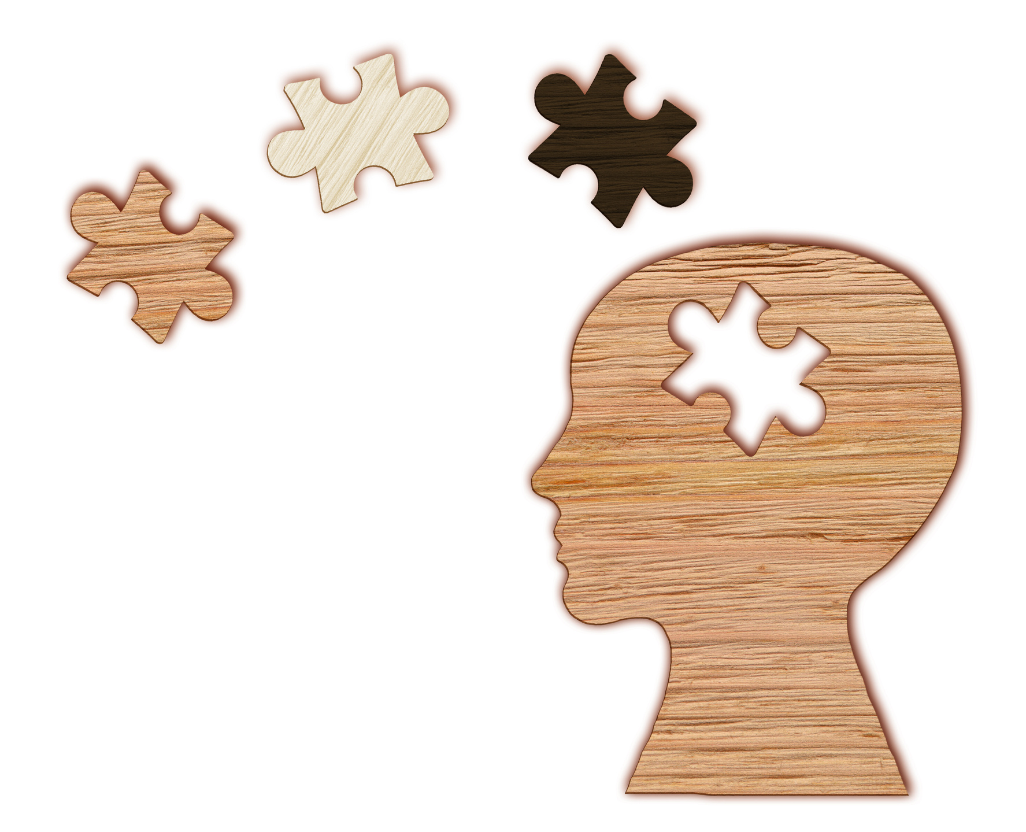

Slide 2

RICHARD BRANSON
“The important thing is that you've got a strong foundation before you start to try to save the world or help other people."

Slide 3


Devising Solutions
for a key mental health
services challenge
Len Bickman
National Advisory Council ofCMHS
August 29th, 2023

Slide 4


MY FOCUS
Major Problem:
Services face significant challenges in real-world effectiveness

Slide 5





Usual Efforts To Improve Effectiveness Are Not Sufficient
Accreditation, certification, and licensing offer only limited impact
Clinician experience & formal training weakly related to effectiveness
Little evidence that HEDIS quality measurement system is related to clinical outcomes

Slide 6



Effectiveness of Treatment
is Limited
A meta-analysis of 3,782 adult RCTs found small effect sizes
Over 50 years, minimal progress in youth anxiety and ADHD treatments, decline in depression and conduct behavior effectiveness
Recent surge in youth depression, anxiety, suicide rates, psychiatric admissions, and risky behaviors

Slide 7


OUR ADVANTAGE:
NUMEROUS INNOVATIVE UNIVERSAL SOLUTIONS FOR IMPROVING EFFECTIVENESS
Value-Based Health Care (VBHC)
Measurement-Based Care (MBC)
Measurement Feedback Systems (MFS)
Task Shifting
Evidence-Based Treatments (EBT)
Decision Support Systems (DSS)
Precision Mental Health (PMH)
Causal Data Sciences (CDS)
Artificial Intelligence (AI)

Slide 8

HOWEVER...
IMPLEMENTATION ISSUES HAVE IMPEDED
THEIR USE AND IMPACT
Measurement of EBT implementation fidelity is inadequately measured
Causal Data Sciences has low adoption rate
Routine care data systems are typically flawed, incomplete, and poorly designed
MBC flawed implementation limits impedes learning from billions $ spent on services
Meta-analyses of RCTs MFSs had poor implementation and limited feedback utilization
Substantial gaps persist in EBT utilization in clinical practice.
Only 12% programs were prepared for implementation and had sufficient fidelity post-implementation

Slide 9





The Inadequacy Of Foundational Measurement And Data Infrastructures Is A Cause of Implementation Problems
No learning behavioral health care system that collects data on services and outcomes to enhance practice
U.S. lacks a data collection system to assess benefits of treatment
AI development necessitates substantial data sets and real-world experimentation
Enhancing CDS with AI could enhance its adoption and performance
Precision Mental Health needs extensive longitudinal data sets

