Slide 1
The (a) Problem
Jeffrey Aaron, Ph.D.
University of Virginia

Slide 2
Juvenile Justice System (est. 1899)
The adult justice system is not a good fit for kids
Principle of parens patriae: steer them back onto a healthy developmental trajectory
Identify and respond to offenders’ needs

Slide 3
125 Years of Progress (overall)
Adolescent development
Mental health
Trauma
Informed by empirical research

Slide 4
Better than the adult system
Youth Transferred
to Adult Court
More Recidivism
Holding offense, risk, other relevant variables constant
Youth Retained
in Juvenile Court
Less Recidivism

Slide 5
But far from good enough
Processing in the juvenile justice system
is an ineffective intervention!

Slide 6
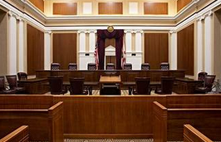
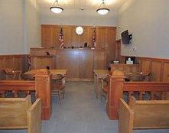
Perhaps because…

Slide 7


Perhaps because…
Adversarial
Sanction-based

Slide 8
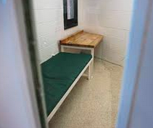
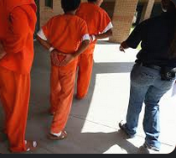



What Works for Kids?
Collaborative engagement
Done with, not to

Slide 9

What Works for Kids?
Behavior
Behavior
Cause
Understand behavior as having meaning
Address causes and underlying problem
  MH, SU, trauma, family issues, disenfranchisement…
Cause
Cause
Consequence

Slide 10

What Works for Kids?
Legal Protections
Due Process Rights
Trial
Beyond Reasonable Doubt
Early intervention
Timely responses
Proportionality
Fairness
(Not speedy trial)
Often
Months to resolution
No services in interim
No intervention at all
?

Slide 11
Often the Default
Public Safety Needs
Youth’s
Needs

Slide 12
Often the Default
Public Safety Needs
Youth’s
Needs

Slide 13
Solutions

Slide 14
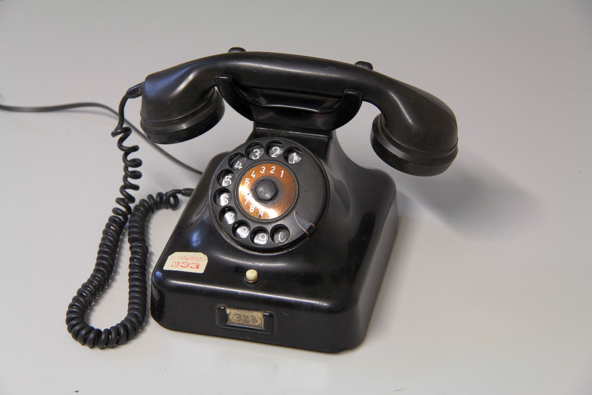

Slide 15

CHANGE
THE
SYSTEM

Slide 16
Adversarial
INQUISITORIAL

Slide 17
Sanction-Based
RESTORATIVE

Slide 18
Perhaps more realistically
If the system is not effective…
Keep kids from coming into it

Slide 19
Prevention
Limit Deepening Involvement
Early Intervention
Divert at intake
Reduce charges
Limit initial detention
Shorten period of incarceration
Keep in juvenile system
Academic, social and behavioral supports for at risk youth
Family intervention and support
Community programming and opportunities

Slide 20
Limit Deepening Involvement
Early Intervention
Divert at intake
Reduce charges
Limit initial detention
Shorten period of incarceration
Keep in juvenile system
Academic, social and behavioral supports for at risk youth
Family intervention and support
Community programming and opportunities

Slide 21
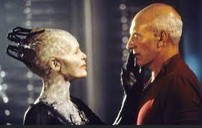

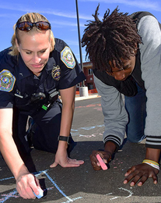
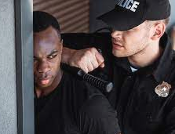
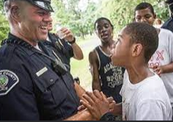
First Contact
Opportunities for
Engagement
Arrest
Support
Escalation
Trauma
Doing nothing
Violence
Mentoring

Slide 22
Outcomes Determined By
Police department policy
Police department expectations
Youth expectations and behavior
Officer expectations and behavior
External events
OFFICER TRAINING

Slide 23
So, How Much Training Do Officers Get?
Test
What percent of academy time is spent on youth?
A)1%
B) 10%
C) 25%
D) 40%
A) 1%

Slide 24
Consider
Percent of youth arrests for discretionary or low level offenses
Impact of LE contact on youth
Statements from law enforcement authorities about the need for training
Police officers perceptions about the need for training
The first “R” in RNR
The importance of a developmentally informed, trauma informed, mental health informed understanding of kids for anyone working with kids

