Slide 1
Omaha Meeting
Problem Statement
Anne Kuppinger

Slide 2

Notes:
Can’t ignore the context in which we are trying to ‘do better’
It is simply not enough to provide clinical treatment in a vacuum
Many stress factors
Poverty
Racism
Gun violence
Police violence
Mass incarceration
Dismantling of fragile LGBTQ+ rights
Unequal access to health care
Lack of affordable housing
Inaccessible childcare
Climate crisis
Vilification of undocumented people
Treadmill to barely meet basic needs

Slide 3

Why bother?
I’m afraid I’ll lose control.
Will this even work?
I have no idea where to go.
Will they believe me?
Will they blame me?
Will they ‘get?’ me?
Is this a safe place for me?
Notes:
These are the questions people are asking when they even begin to contemplate seeking services
Outreach and supportive connections are critical
All these questions stand between acknowledgement that help is needed and actually asking for help
That wall is even higher for people of color, folks who have a history of trauma, low-income, undocumented

Slide 4

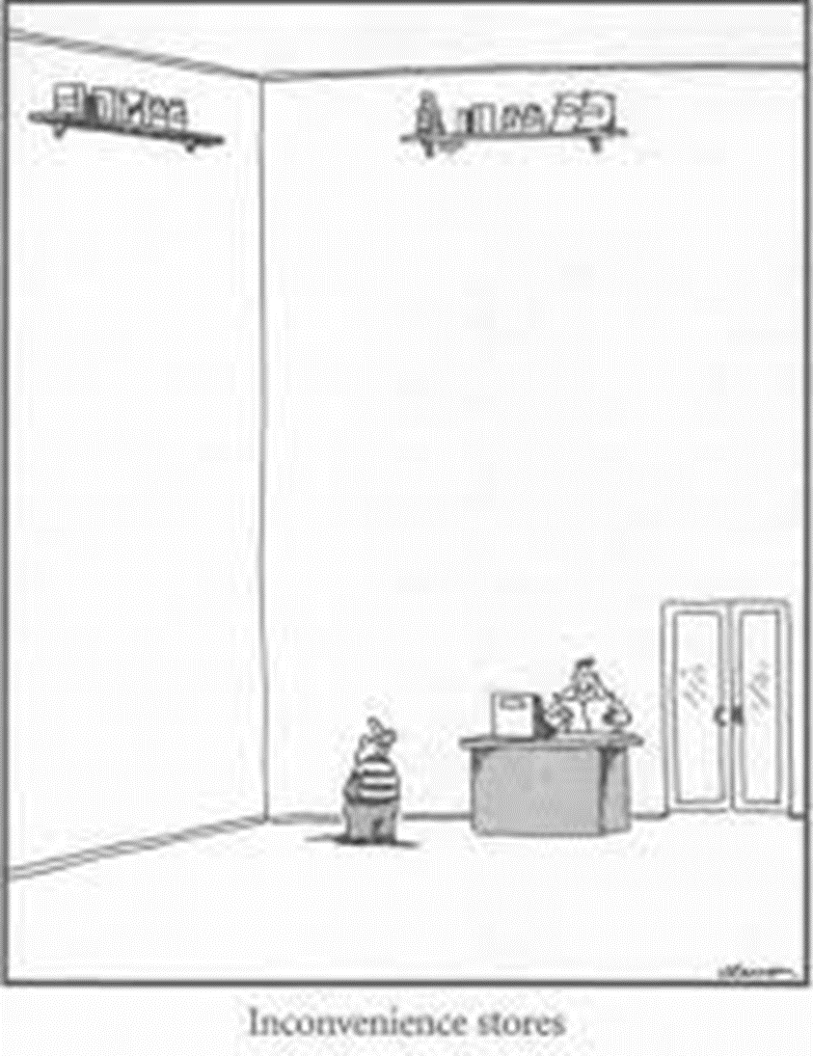
Notes:
Then you get this sort of path to actually find help.....

Slide 5








Stigma
Unclear how to get help
One size fits no one
Access problems
Isolation and loneliness
Short on empathy
Skepticism
Not being heard

Slide 6
Priority Needs...
Universal maternal mental health care
Training & resources in schools
Real ‘system’ for transition age youth 16-25, especially for young people in out-of-home care, and justice involved
Comprehensive, easy to access crisis services
No wait lists
Aligned fiscal and service approaches
Access to Youth, Family, and Adult Peer Services

